Slide 1
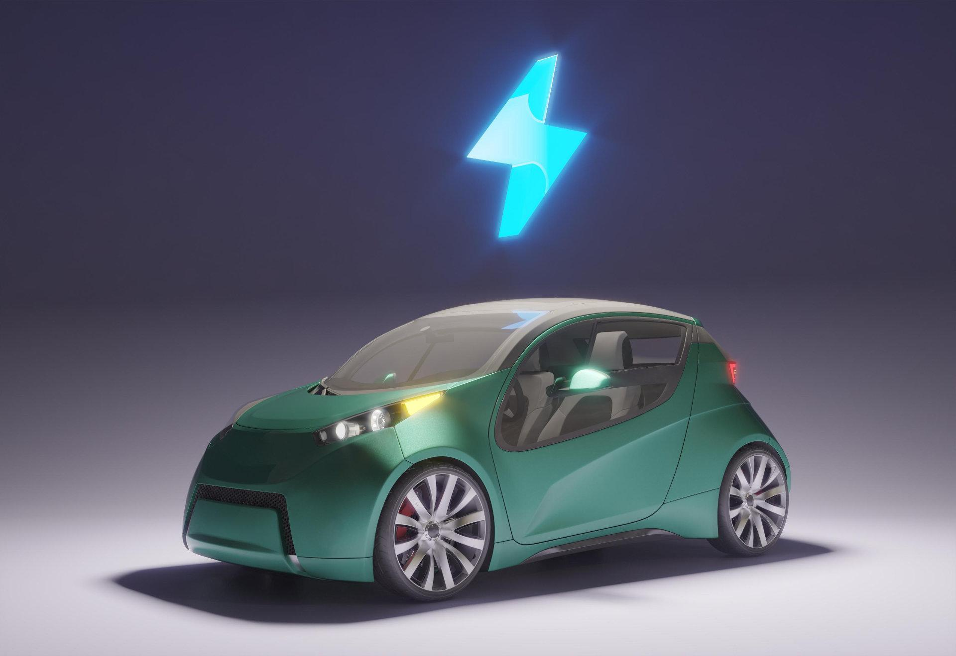

“ FUELING THE FUTURE”
EV – SALES SPARK : INSIGHTS AND ANALYSIS📊
PRESENTED BY – PRIYANSHI

Slide 2

TABLE OF CONTENTS
01
02
03
04
05
06
OUR COMPANY
PROJECT GOALS
OUR WORKING
INSIGHTS OF REASEARCH QUESTIONS
OUR TEAM
You can describe the topic of the section here
EV – SALES DASHBOARD
You can describe the topic of the section here

Slide 3
OUR COMPANY
Atliq Motors Is An Automotive Giant From The USA Specializing In Electric Vehicles (EV). In The Last 5 Years, Their Market Share Rose To 25% In Electric And Hybrid Vehicles Segment In North America. As A Part Of Their Expansion Plans, They Wanted To Launch Their Bestselling Models In India Where Their Market Share Is Less Than 2%. Bruce Haryali, The Chief Of Atliq Motors India Wanted To Do A Detailed Market Study Of Existing EV/Hybrid Market In India Before Proceeding Further. Bruce Gave This Task To The Data Analytics Team Of Atliq Motors And Peter Pandey Is The Data Analyst Working In This Team.

Slide 4
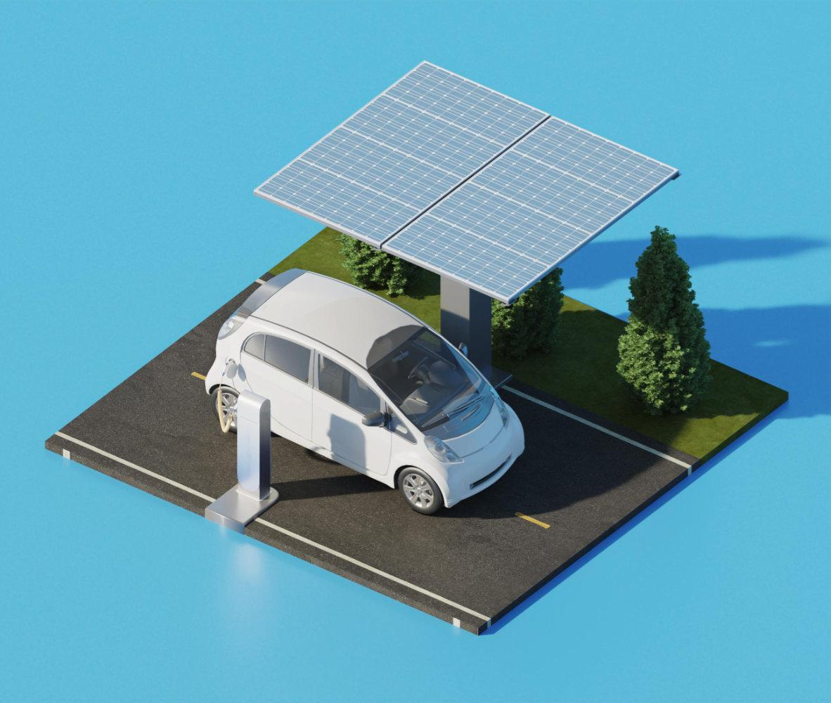

Designing a dashboard with your metrics and analysis. The dashboard should be self-explanatory and easy to understand. Answering all the primary questions and secondary questions and finding the valuable insights for the company . Identifying the trends, growth , declination etc. Offer strategies and recommendations to expand the business in a successful way.
PROJECT GOALS
RESUME PROJECT CHALLENGE BY CODEBASICS

Slide 5
WHAT ARE THE WORKING
01
02
03
CHALLENGES
DASHBOARDS
INSIGHTS
We Are Working With A Complex Dataset Which Includes Three Tables-dim Dates,ev By Makers And Ev By State.
Designed An Interactive Dashboard
Gathered All Insights Related To The Company

Slide 6
– Gavin Newsom
“ Electric Vehicle Are Not Just A Mode Of Transportation , But Solution To Climate Change ”

Slide 7
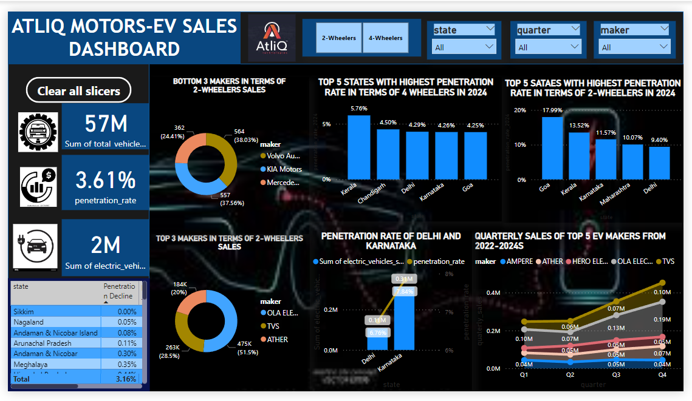

Slide 8
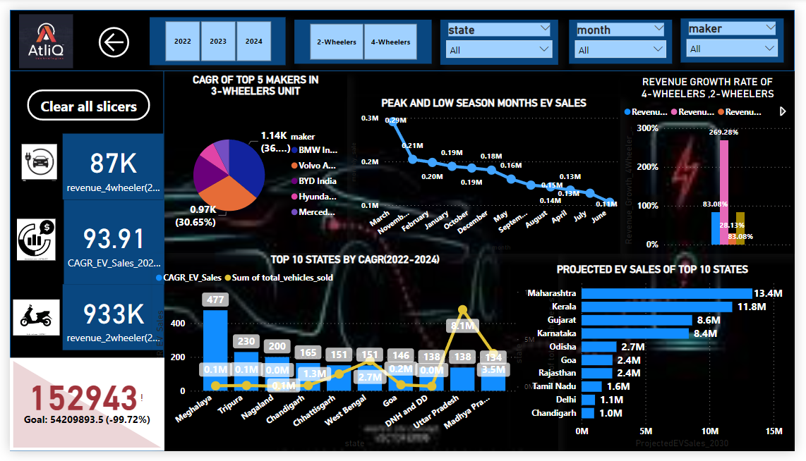

Slide 9

NOW -:
Petrol’s dark shadow looms large , costing a pall of pollution over our planet.

Slide 10
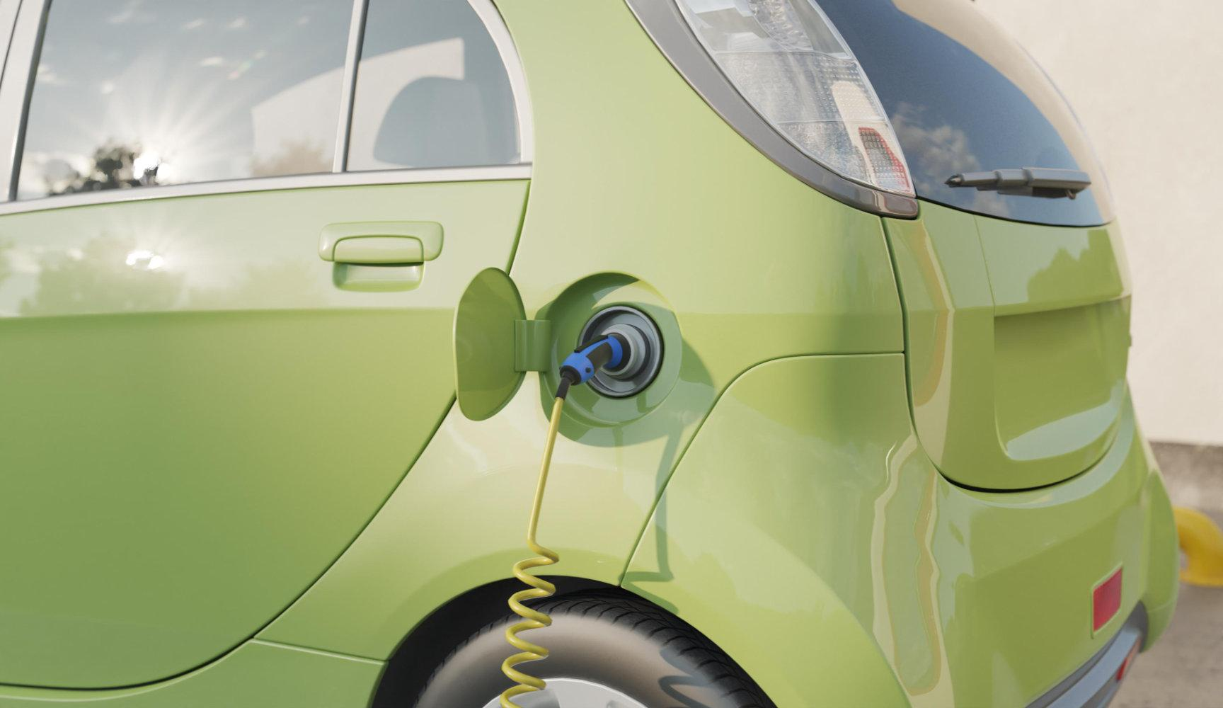
FUTURE
Drive electric , breathe easy: a cleaner future starts with every charge

Slide 11
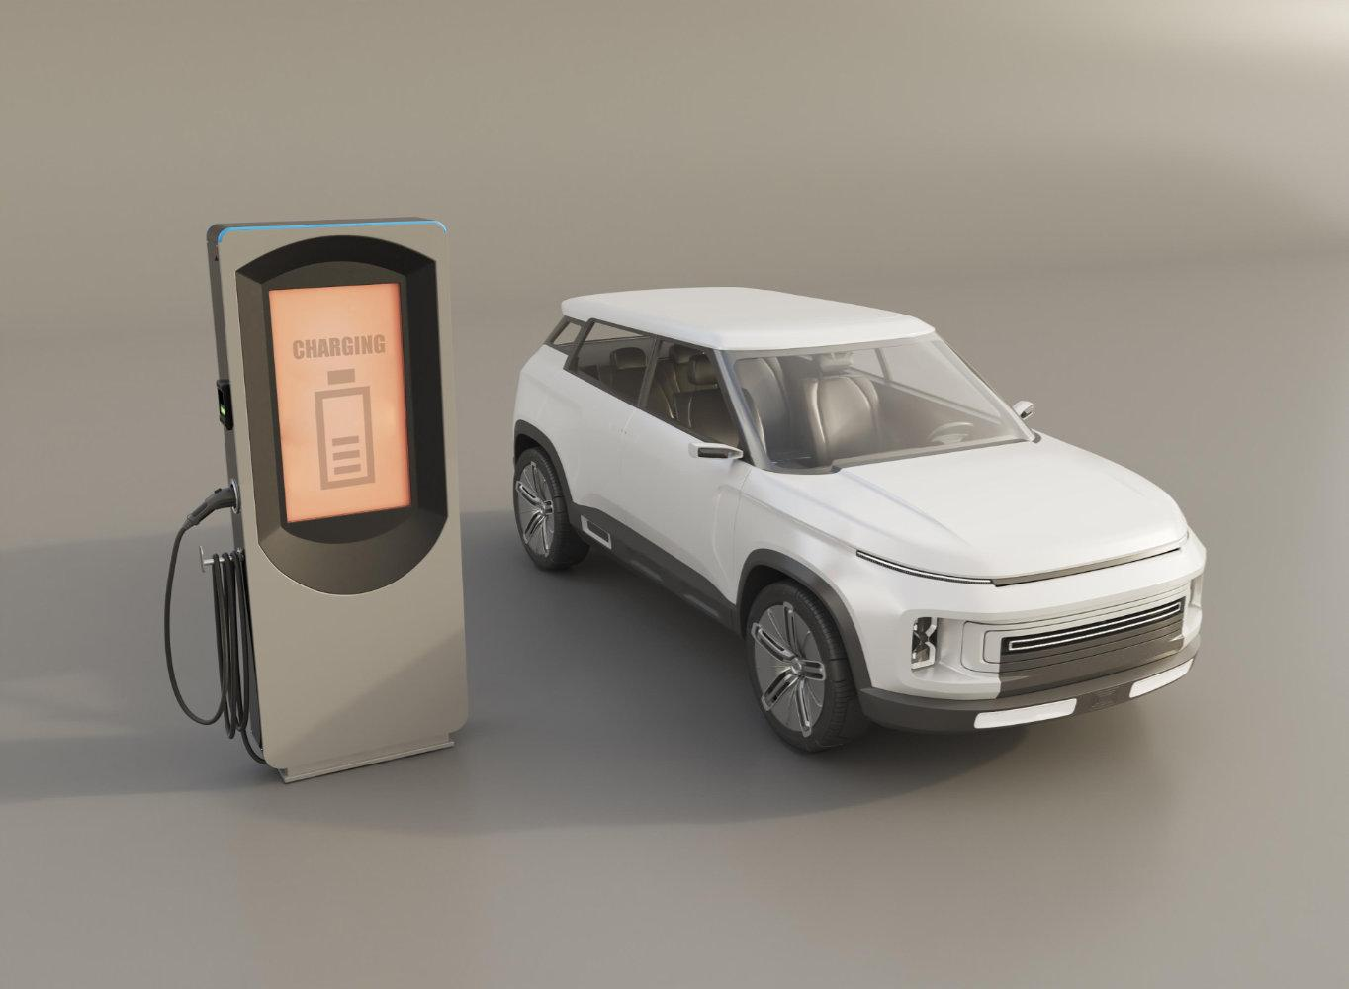
Primary Reasons for Choosing 4-Wheeler EVs in 2023 and 2024 ? Cost Savings: Many customers are drawn to 4-wheeler EVs due to lower fuel costs and reduced maintenance expenses compared to traditional internal combustion engine (ICE) vehicles. Environmental Concerns: Growing awareness of climate change and pollution has led to a preference for eco-friendly vehicles, making EVs more appealing. Government Incentives: Financial incentives, including subsidies and tax breaks, have made EVs more affordable, driving higher adoption rates. Reasoning: These factors have collectively reduced the total cost of ownership, making 4-wheeler EVs a more attractive option for cost-conscious and environmentally aware consumers.
SECONDARY QUESTIONS

Slide 12
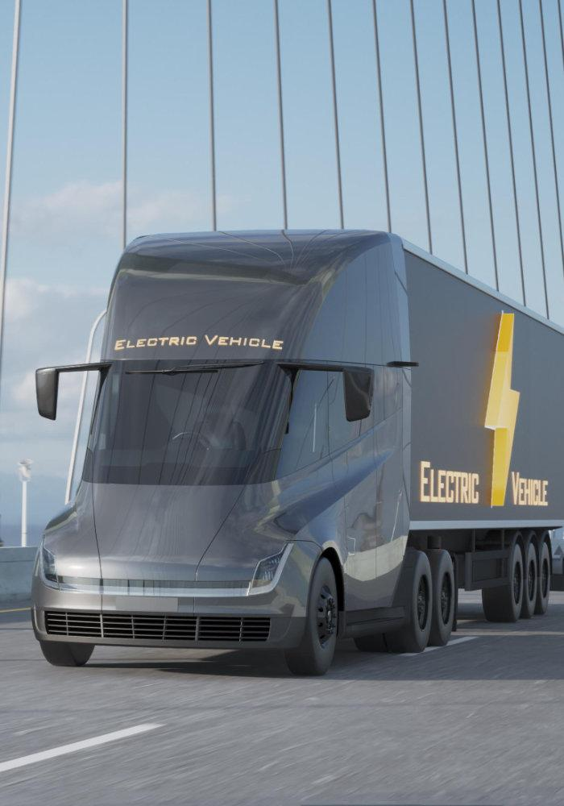
Primary Reasons for Choosing 4-Wheeler EVs in 2023 and 2024 ?
Cost Savings: Many customers are drawn to 4-wheeler EVs due to lower fuel costs and reduced maintenance expenses compared to traditional internal combustion engine (ICE) vehicles.
Environmental Concerns: Growing awareness of climate change and pollution has led to a preference for eco-friendly vehicles, making EVs more appealing.
Government Incentives: Financial incentives, including subsidies and tax breaks, have made EVs more affordable, driving higher adoption rates.
Reasoning: These factors have collectively reduced the total cost of ownership, making 4-wheeler EVs a more attractive option for cost-conscious and environmentally aware consumers.

Slide 13
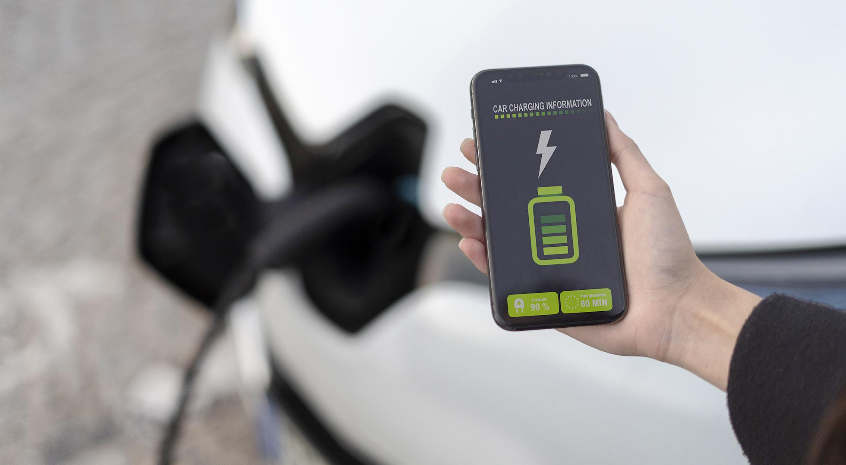
Impact of Government Incentives and Subsidies on EV Adoption ?
Government incentives have significantly accelerated the adoption of EVs by reducing the upfront cost for consumers.
States like Gujarat and Maharashtra have been at the forefront, providing substantial subsidies and incentives, including rebates and reduced road taxes.
Reasoning: The financial support from the government has lowered the entry barrier for consumers, leading to increased penetration rates in these states.

Slide 14
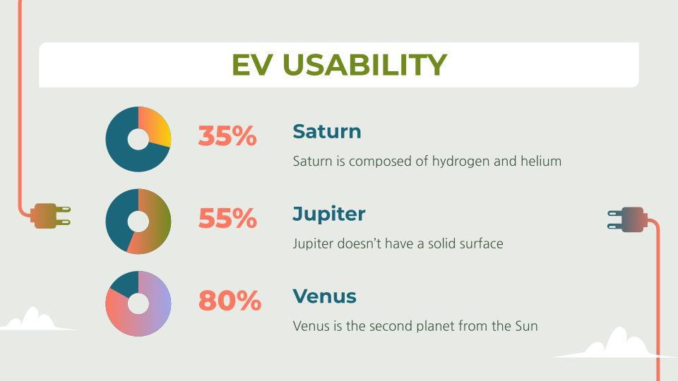
Correlation Between Charging Infrastructure and EV Sales?
A robust charging infrastructure has been directly linked to higher EV sales and penetration rates. For example, states like Karnataka, Maharashtra, and Delhi, which have invested heavily in charging stations, show the highest EV sales.
Reasoning: The availability of charging stations reduces range anxiety among consumers, making EVs a more viable option for everyday use.

Slide 15
Correlation Between Charging Infrastructure and EV Sales?
A robust charging infrastructure has been directly linked to higher EV sales and penetration rates. For example, states like Karnataka, Maharashtra, and Delhi, which have invested heavily in charging stations, show the highest EV sales.
Reasoning: The availability of charging stations reduces range anxiety among consumers, making EVs a more viable option for everyday use.

Slide 16

5. Ideal State for Manufacturing Unit ?
Recommended State : Maharashtra.
Reasoning: Maharashtra offers generous subsidies, ease of doing business, a well-established supply chain network, and political stability. This combination makes it an ideal location for setting up a manufacturing unit.

Slide 17
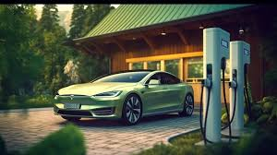
Top 3 Recommendations for AtliQ Motors ?
1. Expand Charging Infrastructure Partnerships.
2. Focus on Affordable EV Models.
3. Leverage Digital Marketing.
Reasoning: These strategies would enhance market penetration, address consumer needs, and position AtliQ Motors as a leader in the EV industry.

Slide 18

THANK YOU!
priyanshikhandelwal2107@gmail.com
I am grateful for your time and appreciate your engagement and interest .

